Slide 1
ONLINE SEAT BOOKING SYSTEM.

Slide 2
TEAM MEMBERS.
VIKASH KUMAR SHRIVASTAVA.
LinkedIn id: linkedin.com/in/vikash-kumar-shrivastava-6b0650201
MONIT DANGI.
LINKEDIN ID: linkedin.com/in/monitdangi
DEVANSH DIXIT
LINKEDIN ID: linkedin.com/in/devansh-dixit-2970171b8

Slide 3
INTRODUCTION.
Online seat booking project is a software application designed to allow customers to reserve seats for various events or activities, THIS SOFTWARE CAN BE WIDENED TO VARIOUS FIELDS such as movie theaters, concerts, flights, trains, or sports events.
It provides a user-friendly interface that enables users to browse available seats, select their preferred seats, and purchase tickets online.
The system allows users to search for events based on various criteria such as date, time, location, and price. Once the user finds an event they are interested in, they can select the number of seats they want to reserve and choose the specific seats they prefer. The system then generates an invoice and sends it to the user via email, which can be paid online.
The online seat booking system simplifies the process of buying tickets, eliminates long queues at the ticket counters, and allows customers to make reservations from the comfort of their homes.

Slide 4
CLASS DIAGRAM OF SEAT BOOKING SYSTEM.
+----------------------+ +---------------------------------+
| User | | Seat |
+--------------------+ +--------------------------------- +
| -id: int | | -seatNumber: int |
| -name: string | | -seatId :int |
| -email: string | | -buildingName: string |
|-type: int | |-floorNo : int |
|-password : string | |-roomNo : int |
|-bookings : list | +---------------------------------+
+----------------------+ |
| |
| |
| |
+----------------------------+ |
| Booking | |
+----------------------------+ |
| -bookinId: int |- - - - - - - |
| -userId: int |
| -seatId: int |
| -bookingTime/Date |
+-------------------------------+

Slide 5
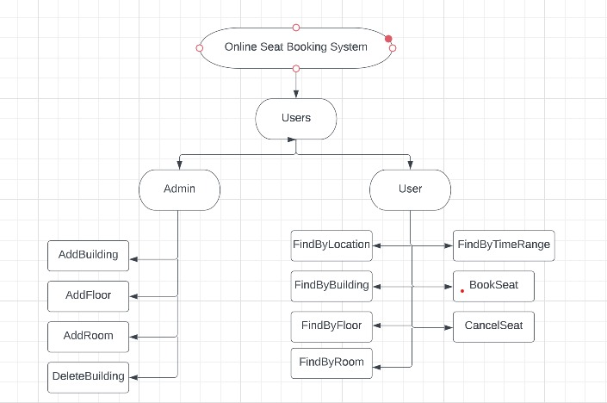
FLOW DIAGRAM.

Slide 6
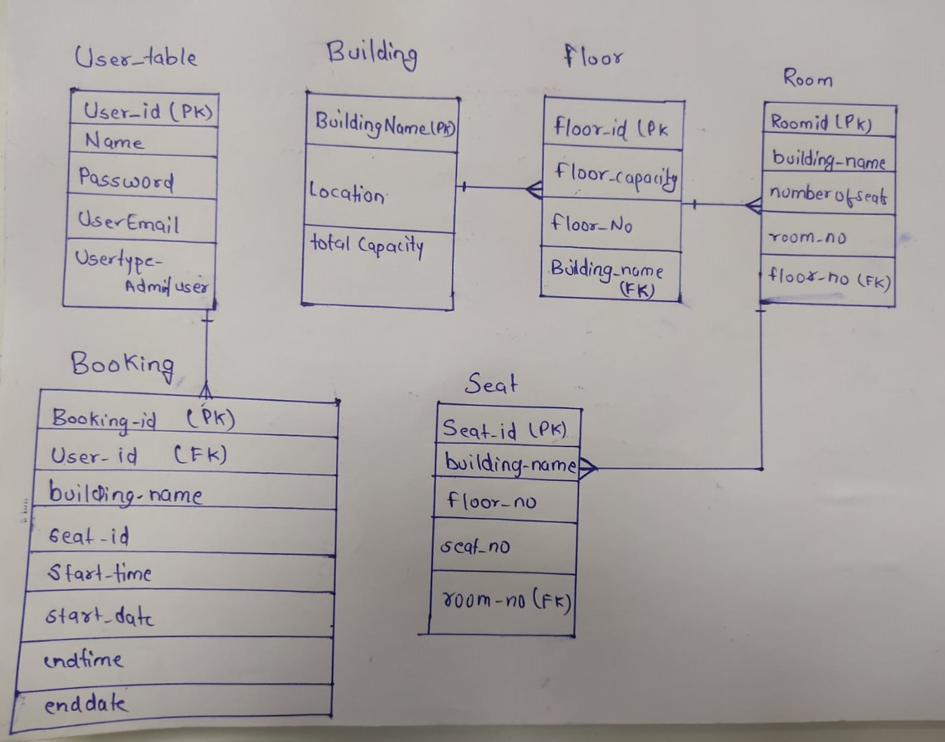
ER- DIAGRAM.

Slide 7
TECH STACK USED.
JAVA 11.
SPRING BOOT FRAMEWORK.
SPRING REST API.
SPRING DATA JPA.
POSTGRESQL.
POSTMAN.
SONAR LINT.
GIT.

Slide 8


